Slide 1
Technology for Success: Computer Concepts

Slide 2
Module 11
Digital Communication

Slide 3
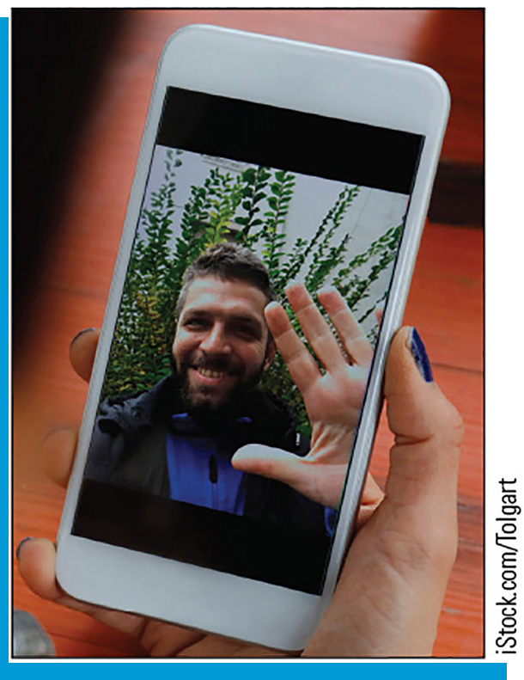
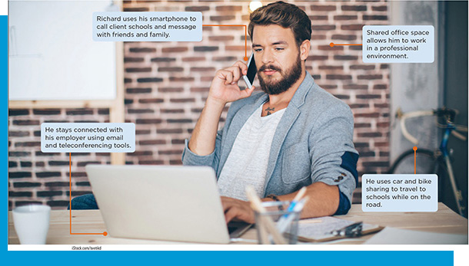
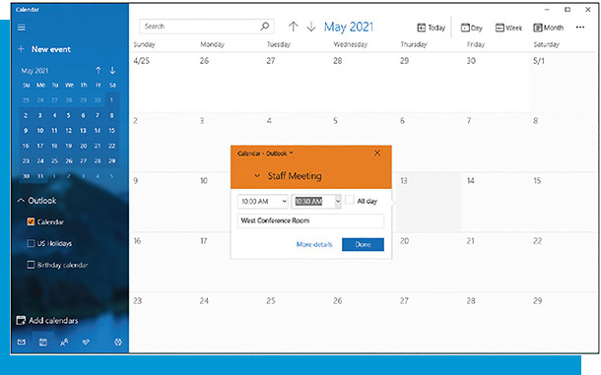
Lesson Objectives
Explain digital communication and its purpose
Evaluate the impact of digital communication in daily life
Use and create multiple types of digital communication

Slide 4
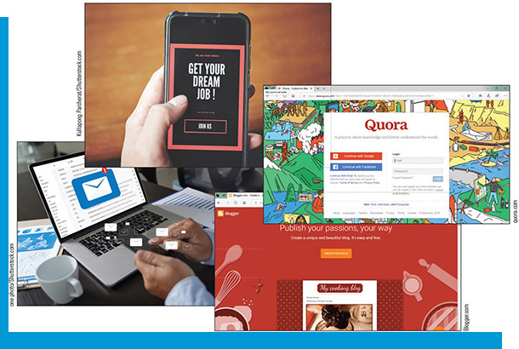
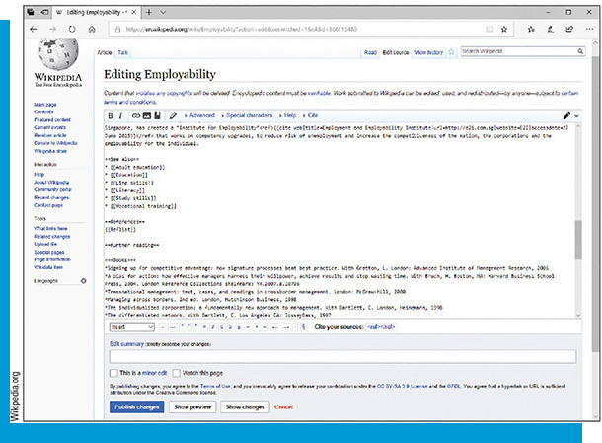
Explain Digital Communication and Its Purpose
Describe common types of digital communication
Define types of blogs, social networks, and wikis

Slide 5
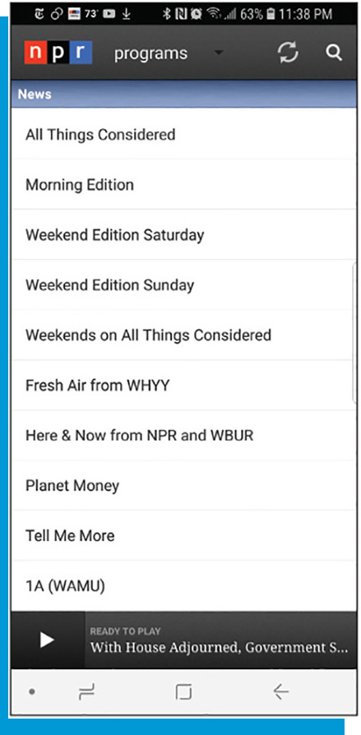
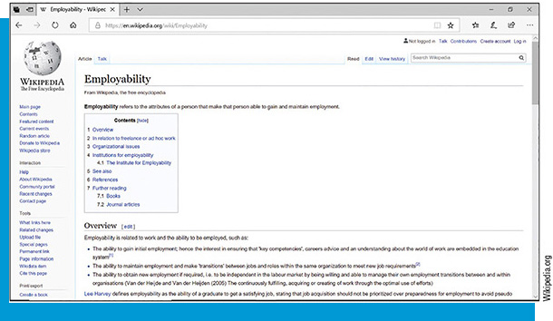
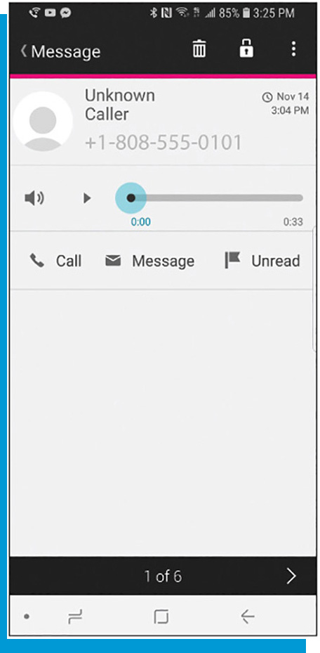
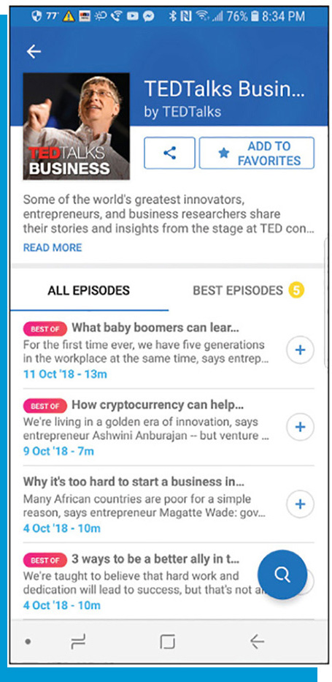
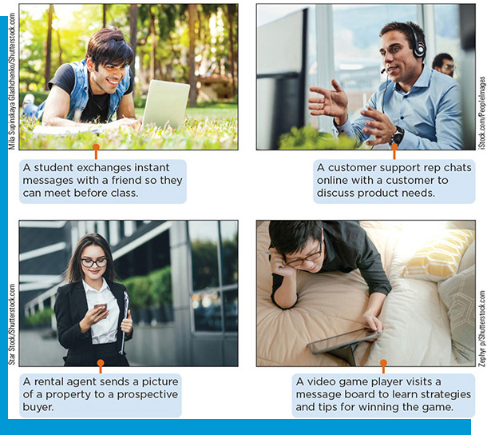
Common Types of Digital Communication
Blogs
Wikis
Email
Electronic messaging—text messaging, chatting, multimedia messaging, voice messaging/voice mail, voice-to-text
Podcasts/video podcast
Web/video conference
Social media
Social networks

Slide 6
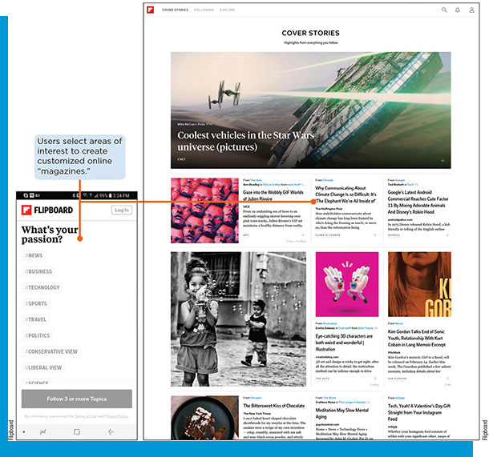
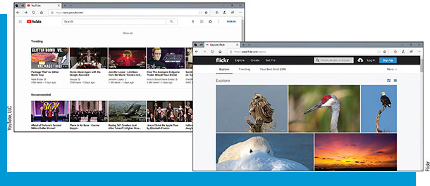
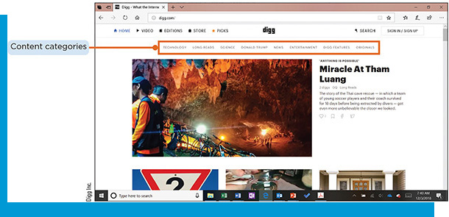
Blogs, Social Networks, and Wikis
Types of blogs
Vlogs/photo blogs
Content aggregators
Microblog
Live blog
Types of social networks
Media-sharing networks
Consumer review networks
Discussion forum networks
Types of wikis
Aggregating content
Social curation

Slide 7
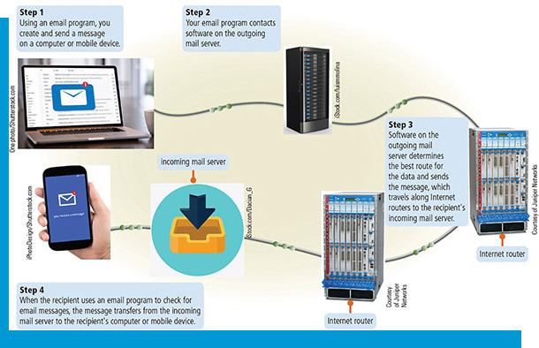
Evaluate the Impact of Digital Communication in Daily Life
Explain the significance of email and how it is used
Explain the importance of netiquette
Evaluate social media
Evaluate social networking

Slide 8
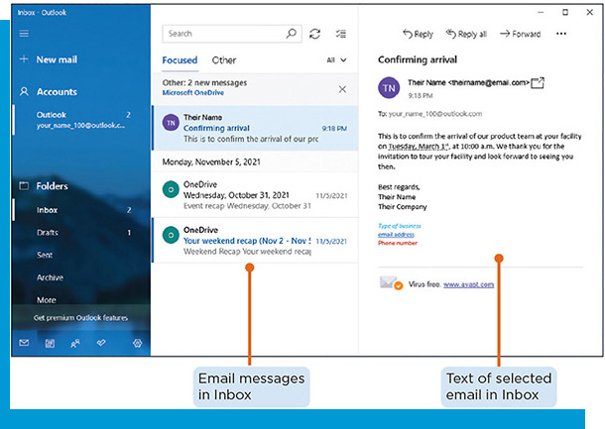
Email
An email can consist of only text or can include an attachment
Most email programs let you send an email to the intended recipient and C C or B C C others
Recipients can respond to a message by using the Reply or Reply All feature
Email software also includes built-in folders for managing messages. Older messages can be archived

Slide 9
Netiquette
It is vital that you follow the rules of Internet etiquette, known as netiquette, to protect yourself, your family, and your career
Personal photographs can be shared, causing untold loss of reputation, personal privacy, and employment
Posting unflattering, false, or confidential comments about employers can result in losing one’s job
Others whose electronic missteps “went viral” have had their personal information spread online and have had to relocate

Slide 10
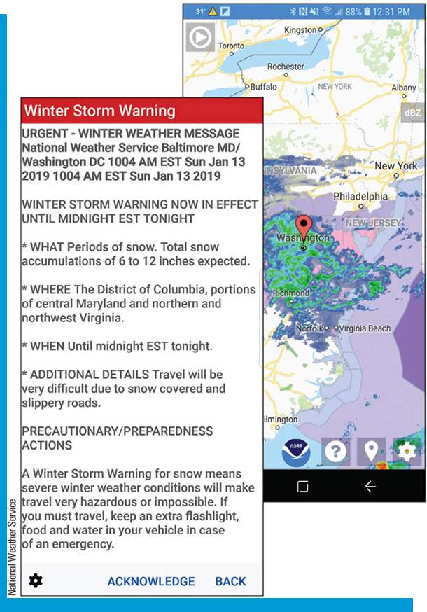
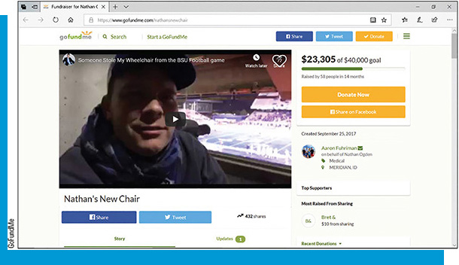
Social Media
Positive effects
Enabling learning
Keeping in touch with the world
Interactive communication
Gather support
Crowdsourcing/crowdfunding
Negative effects
Disinformation
Scams
Technology addiction
Technology overload

Slide 11
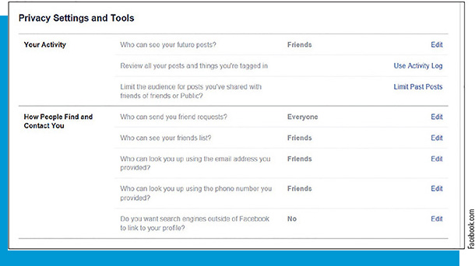
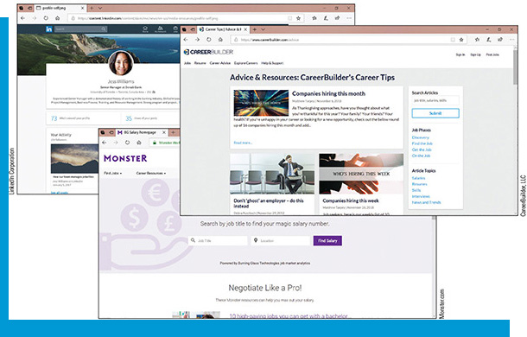
Social Networking
Positive Effects
Keeping in touch with other people
Interactivity
Growing a career
Immediacy
Information control
Business and social networking
Negative Effects
Loss of privacy
Exposure to illegal activities
Loss of information control
Decreased employability
Downsides for businesses

Slide 12
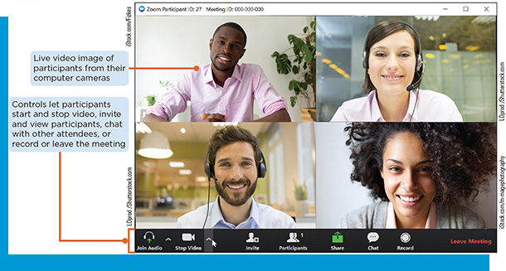

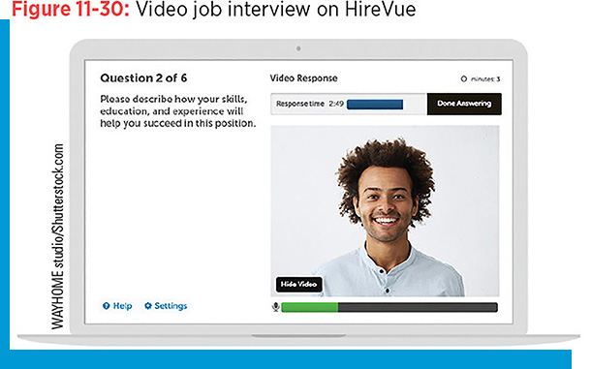
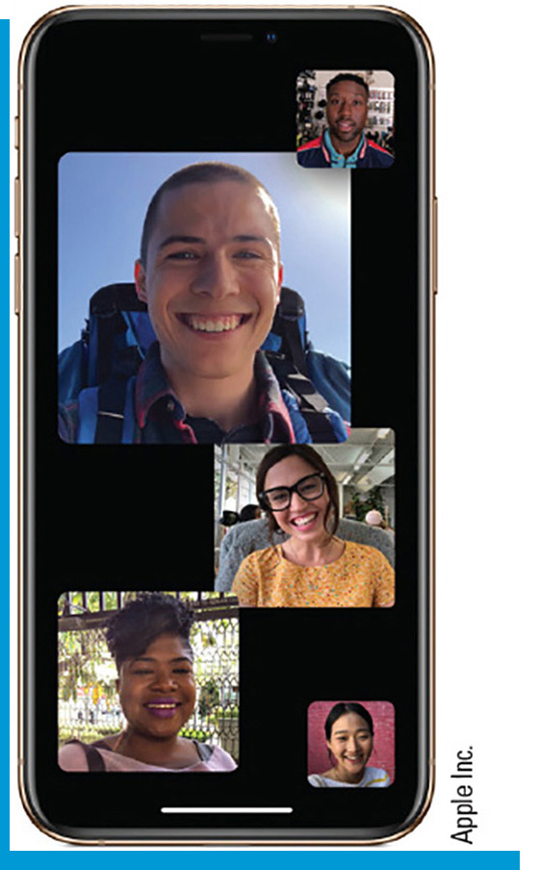
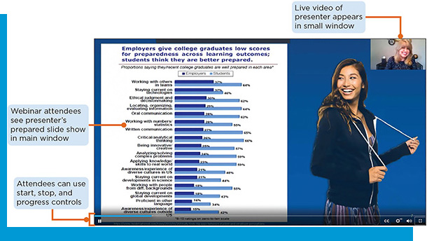
Use and Create Multiple Types of Digital Communication
Use multiple types of digital communication following standard netiquette guidelines
Create digital communication, including emails and blogs, that follows netiquette
Attend video conferences or webinars to further develop a skill
Create business social network posts that follow netiquette

Slide 13
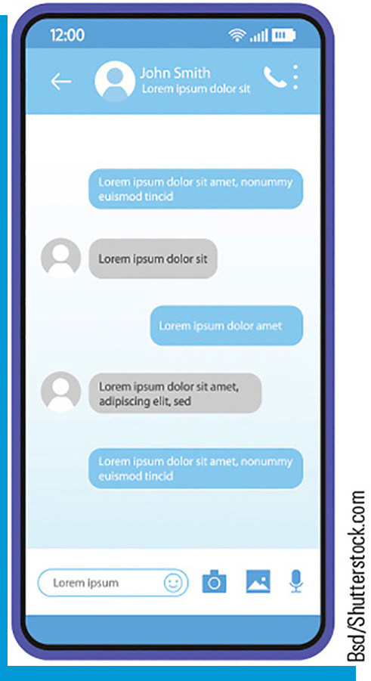
Use Digital Communication Following Netiquette (1 of 3)
Internet etiquette guidelines
Treat others as you want them to treat you
Be polite, and avoid wording that might seem offensive, passive-aggressive, suggestive, or argumentative. Take care when using humor or sarcasm.
Take a neutral stance on controversial subjects
Read your messages before sending them and correct errors in spelling, grammar, and tone
Consider email as public communication, because people might forward your message to
Remember that a human being is at the other end of your communication

Slide 14
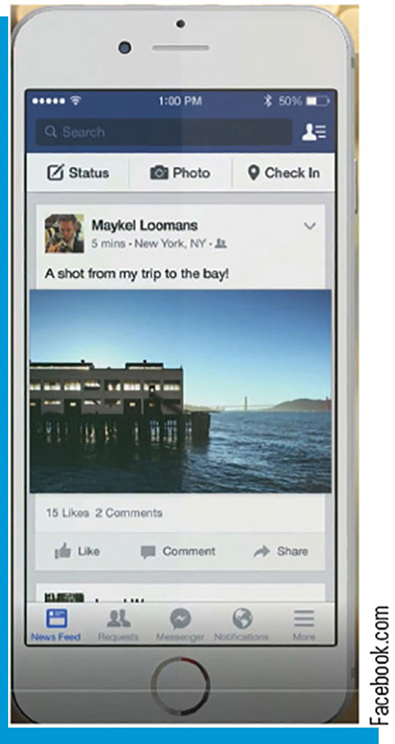
Use Digital Communication Following Netiquette (2 of 3)
Personal social networking guidelines
Respect other participants.
Get to know other members before adding them as friends
Don’t overshare; keep messages short and focused
Before posting comments, ask yourself how readers will react to it
Do not take an online discussion in a different, unrelated direction (“hijacking a thread”)
Do not post anything that may be considered cyberbullying
Do not monitor or keep track of a member’s activities or whereabouts, which could be considered cyberstalking
Protect your online reputation

Slide 15
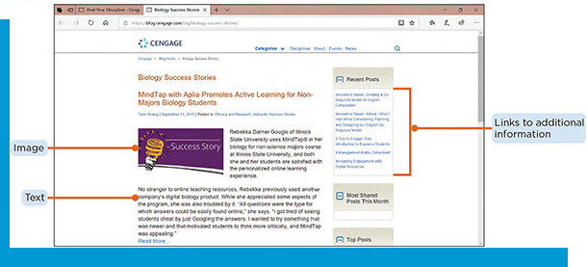
Use Digital Communication Following Netiquette (3 of 3)
Blog guidelines
As a blogger, you’re publishing information online that others might rely on to make decisions. Make sure the information you post is accurate and up to date.
Acknowledge any connections you have with companies and people you endorse
Use good judgment and basic courtesy when commenting
Don’t engage in flaming, which is posting hostile or insulting comments about another online participant

Slide 16
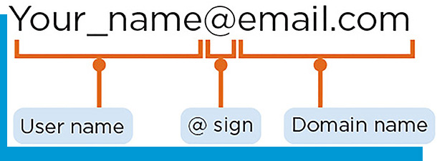
Create Digital Communication That Follows Netiquette (1 of 2)
Creating email addresses
A unique combination of a user name and a domain name that identifies a specific user on a network
The user name is followed by an @ sign, followed by a domain name that specifies the Internet location of the recipient’s email provider
Creating email messages requires:
An email account with an Internet service provider, school, employer, or website
Email software: an email app (known as an email client) or webmail

Slide 17
Create Digital Communication That Follows Netiquette (2 of 2)
Create blogs with blogware
To create a blog in Blogger:
Sign into Blogger using a Google account
Enter a title and web address for the blog, and then select a template
Use Blogger’s tools to write and publish a post, add images and videos, customize the design, and view the activity on your blog
After creating the home page, create an About page, where you describe yourself
Include tags and links to other webpages

Slide 18

Attend Video Conferences
Table 10-5: Close-Distance Network Protocols
Network protocol | Common use
Bluetooth | Devices communicating with each other over a short range (usually less than 30 feet/9 meters)
R F I D (radio frequency identification) | Radio signals transmitted through antennas, often found in tollbooth transponders or embedded chips in animals
N F C (near field communication) | Used in credit cards, smartphones, and tickets to facilitate close-range communication
IrDA | Remote controls or other data transmission within close proximity

Slide 19
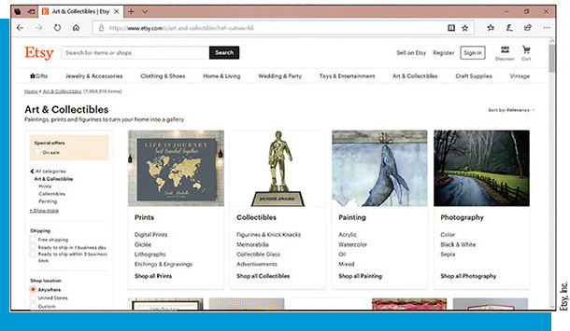
Create Business Social Network Posts (1 of 2)
Table 11-2: Using Social Media in Business
Do | Don’t
Create a profile for your business connections apart from your personal ones. In the professional profile, use your full name and a photo of yourself (not a pseudonym or photo of your pet, for example). | Invite visitors to play games or join other activities that could waste their time.
Offer information that visitors to your page will find valuable. Understand who visits your page (such as colleagues or clients) and adjust the content for these visitors. | Post anything that you don’t want a future or current boss, colleague, client, or other professional contact to read.
Learn about the people who want to follow you or be your friends. Doing so is good business and helps you avoid an embarrassing connection. | Publish posts or comments when you are not yourself, such as when you are tired or angry.
Post photos, messages, and videos that reflect a professional image and appropriate online reputation. | Publish posts or comments about controversial subjects that others might find offensive.

Slide 20
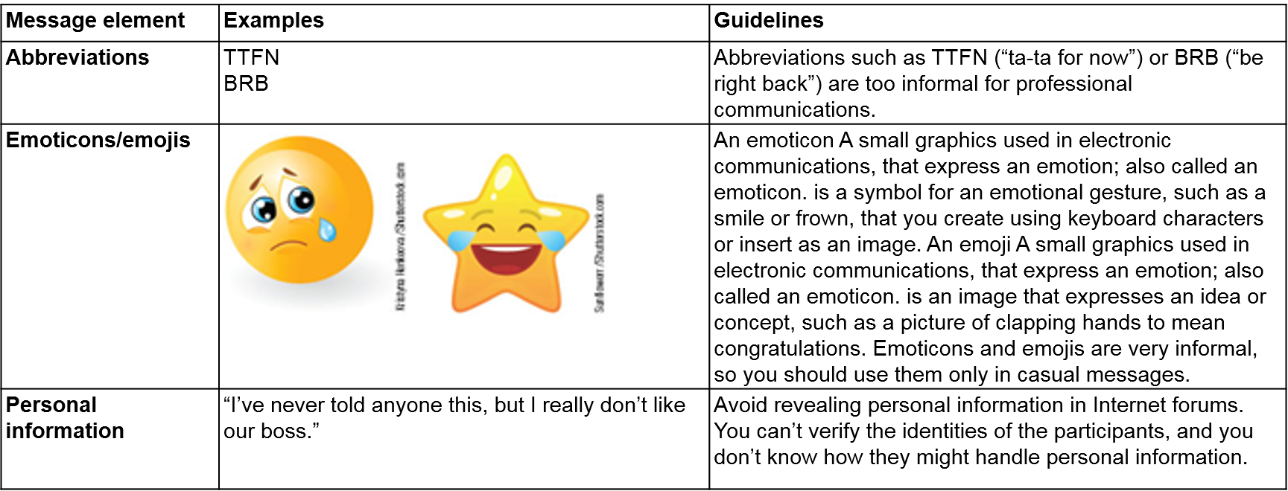
Create Business Social Network Posts (2 of 2)
Table 11-3: Don’t Include in Professional Messaging

